Slide 1
The impact of venue frequency on American Health

Slide 2
Why?
Wallethub ranked 100 American cities based on their health
This health metric included accounted for weight, consequences of health conditions, diet composition, and physical fitness.
Since the foursquare data must be used, could there be significant differences in venue frequency between these two cities?
If there are significant differences, should governments implement restrictions? Could this location data influence future business placement?

Slide 3
Why Portland and Memphis?
Portland
Rank: 97/100 (one of the healthiest cities
Population:
Oregon
Rank: 97/100 (one of the healthiest cities
Population:
Choosing Portland and Oregon allows us to compare cities on the opposite scale without having to adjust for population size

Slide 4
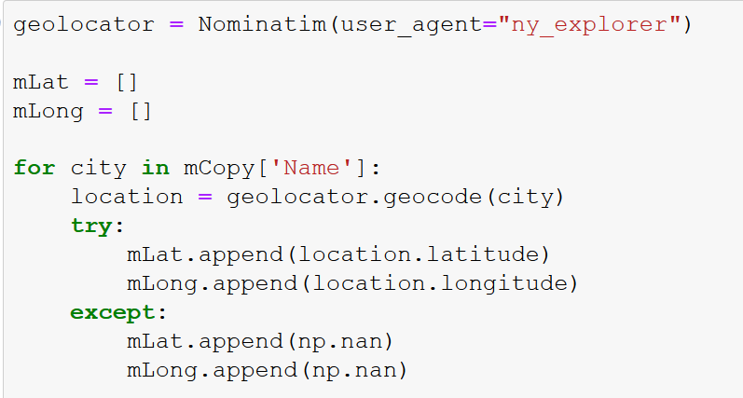
Data acquisition and cleaning
List of neighbourhoods for Portland and Memphis were scraped from Wikipedia
Duplicates and Split neighbourhoods handled
Coordinates for those neighbourhoods acquired using Nominatim geolocator
Iterated through coordinates and queried foursquare for venues in 2.5kilometer radius

Slide 5
Data acquisition and cleaning (continued)
Duplicate venues removed
Venues sorted by ‘Venue Category’ and broken into 4 subcategories:
Fast Food Restaurants
Grocery Stores
Gym / Fitness Centers
Discount Stores (Dollar Stores)

Slide 6
Feature Selection Justification
Fast Food
Larger numbers imply increased consumption of fast food
Lower numbers imply reduced consumption of fast food
Grocery Stores
Grocery stores grant access to healthier food options
Larger number of grocery stores implies more customers
Smaller number implies fewer customers
Fitness Centres
Provide outlet for physical activity
Larger numbers imply increased membership numbers
Smaller numbers imply reduced membership numbers
Discount Stores
People who consume the most subsidized foods have a 37 percent greater risk of obesity than those who consume the least
Larger number may imply lower-income regions
Larger number implies increased consumption of subsidized foods

Slide 7
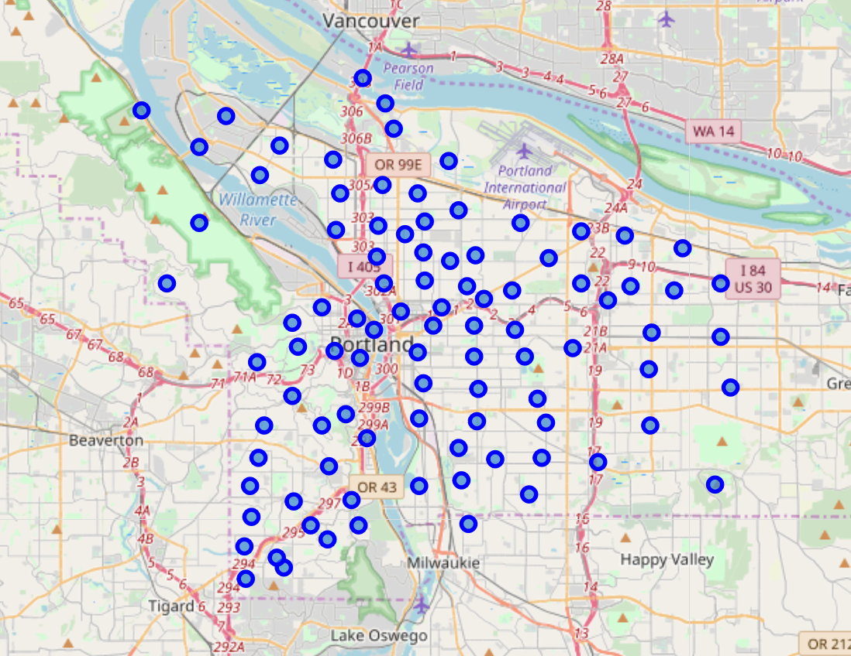
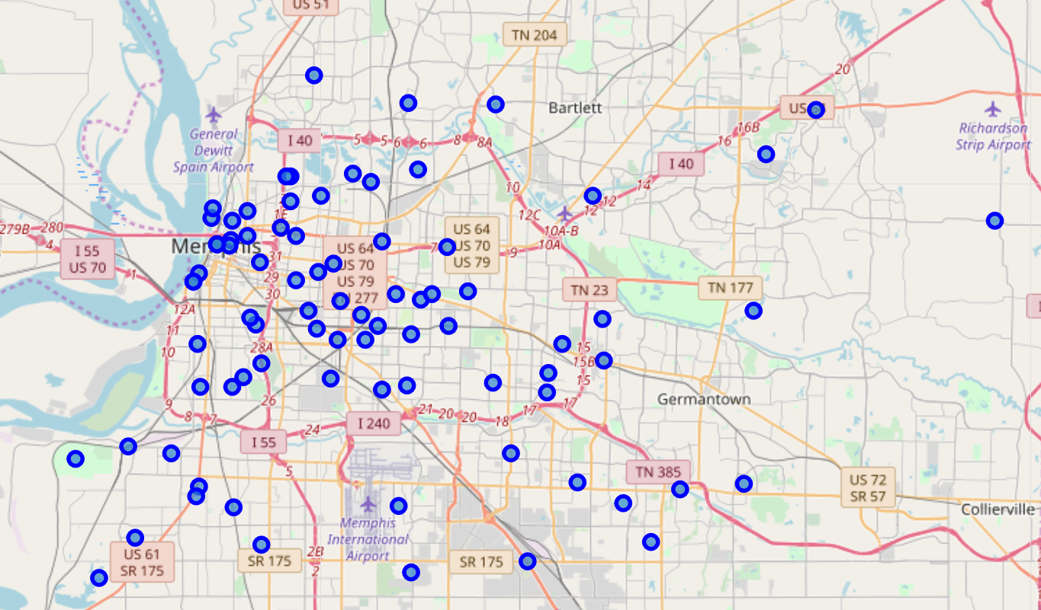
Neighbourhood Visualization
Portland – 94 Neighbourhoods
Memphis – 83 Neighbourhoods

Slide 8
Neighbourhood Counts and Venues
Portland
Memphis
94 Neighbourhoods Collected
2650 Venues Collected (after removing duplicates)
83 Neighbourhoods Collected
2002 Venues Collected (after removing duplicates)
*While there is a difference in sample size, 2 Population Z-Score tests account for that difference

Slide 9
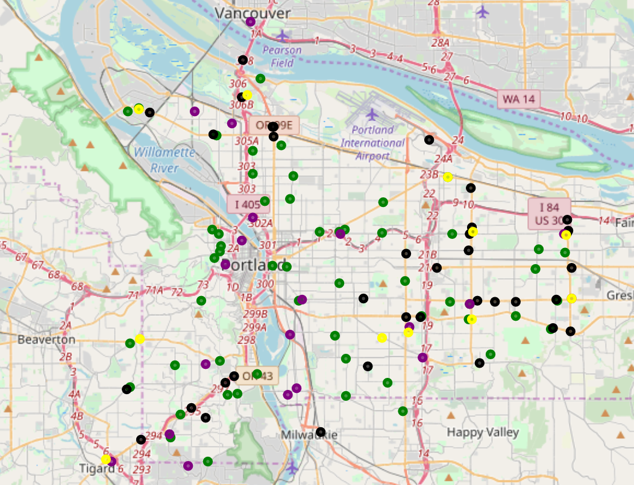
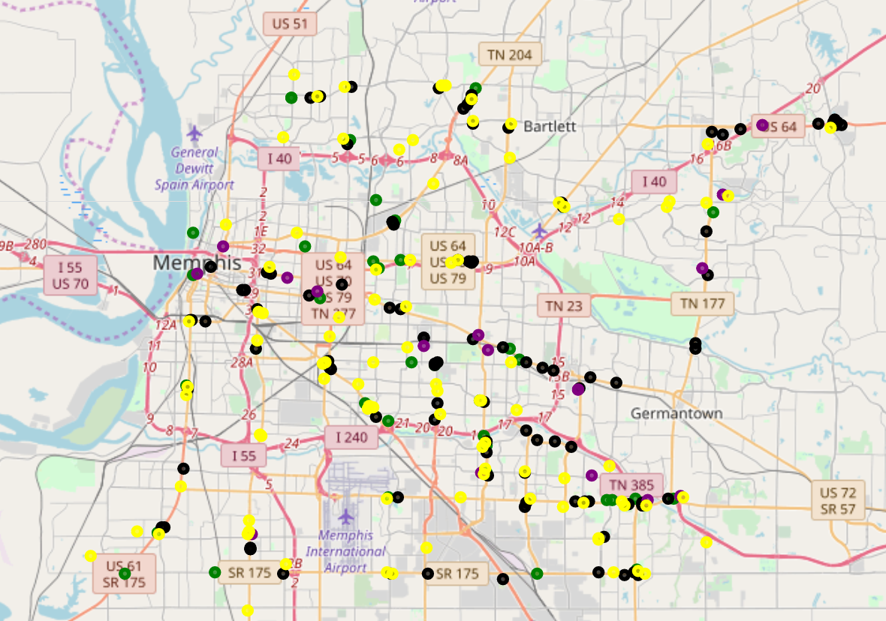
Venue Visualization
Fast Food Restaurants
Grocery Stores
Discount Stores
Portland
Gym / Fitness Centers
Memphis

Slide 10
Neighbourhood Counts and Venues
Portland
Memhpis
94 Neighbourhoods Collected
2650 Venues Collected (after removing duplicates)
83 Neighbourhoods Collected
2002 Venues Collected (after removing duplicates)
*While there is a difference in sample size, 2 Population Z-Score tests account for that difference

Slide 11
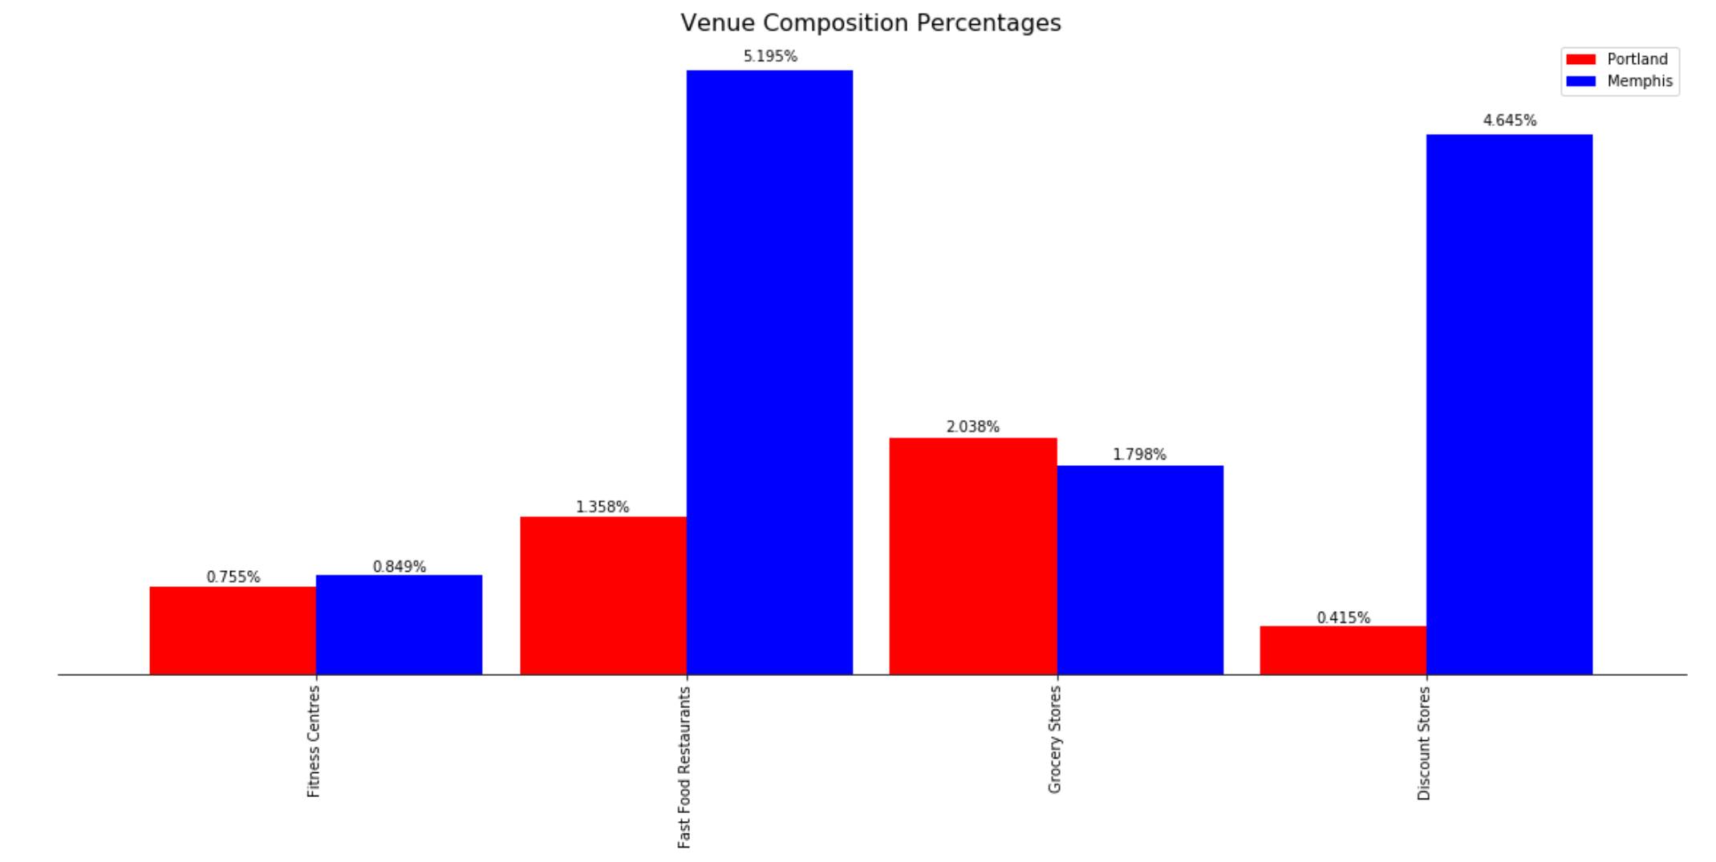
Final Results
Venue Counts divided by total number of venues for percent composition
2 Population Z-Score found the “Fast Food” and “Discount Stores” category differences were statistically significant when comparing the two cities (indicated by stars)

Slide 12
Future Improvements
Using neighbourhoods to query venues is inefficient and may leave gaps. This could be improved by using a grid system to set equidistant queries within city border lines
The Foursquare API limits the number of return results with a free account potentially reducing true results – upgrading may improve data quality

Slide 13
Final Remarks
While statistically significant differences were found in 2 categories (“Fast Food Restaurants” and “Discount Stores”), much more could be learned from other categories (which may serve as superior predictors of population health)

